Slide 1
2-D Lotka Volterra
Pest control of wolves
Participants:
Kiet Tuan Hoang
Notes:
Hello, my name is Kiet and for this project, I have chosen a simplified prey and predator model based on the Volterra lotka as my term project for this semester. This choice was based on the strong tradition of cultivating househould animals in my home country Norway, where agriculture have always been important. Livestocks like sheep and cows were essential, and the biggest liability were wolves. Pest control of wolves have always been important. For this project, the stability prospect of the model is gonna be investigated. This will be done with the use of equilibrium point analysis and phase portraits. This is going to be combined with both nonlinear and linear controllers to see whether it is possible to obtain stability where one wants it. All of the numbers used in this report is ﬁctional and simpliﬁed for the sake of making analysis and implementation.

Slide 2
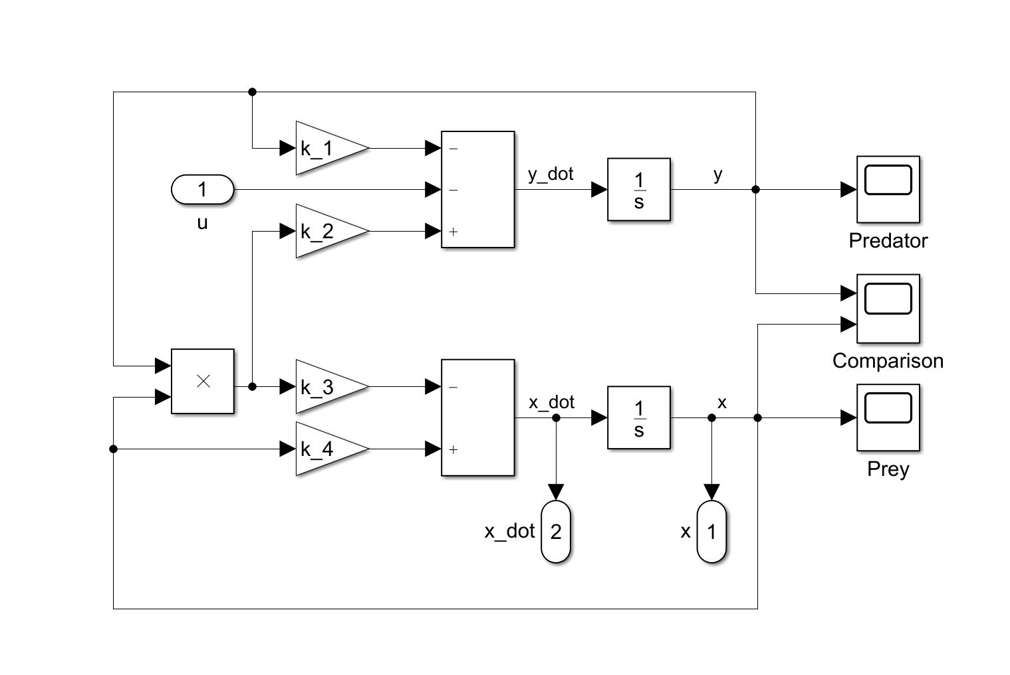
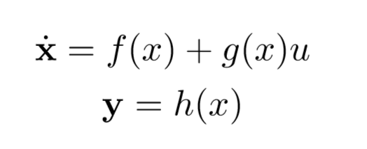
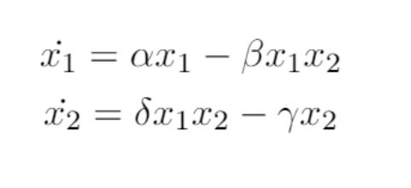
Introduction
Mathematical Modeling
Assumptions
Simplifications
Constraints
Lotka Volterra
Downfall
Notes:
Due to the complexity of Kolmogorov with mutualism, competition and disease, the Lotka Volterra equations solely rely on food. Big assumption is that the prey always ﬁnds food, and if left to be, will always grow with time. This is a valid assumption due to the fact that in this case, most of the preys are household animals which means that they will always have ample with food. Something else which are also assumed is that the predator have limitless appetite, and that the growth of the populations are solely dependent on the size of the two populations.
The biggest constraint on the system is the assumption that neither the input, nor the states can be negative since there are no physical meaning to negative population or negative removal of a population. Large spikes of input are okay, since the removal of large amount of a population would always be possible. Another downfall with the model is the assumption of no
perturbation which are common in biological systems in the form of diseases, natural disasters and seasonal eﬀects such as weather and food supply. One can see later that the system is very sensitive to perturbation with the use of phase portrait on the Lotka Volterra model.
Lotka Volterra equations are usually referred to as the prey and predator equation, which are used to describe the dynamics of biological systems in which two species interact. X is two dimensional vector consisting of prey and predator population, where u and y are the control input and output respectively.

Slide 3
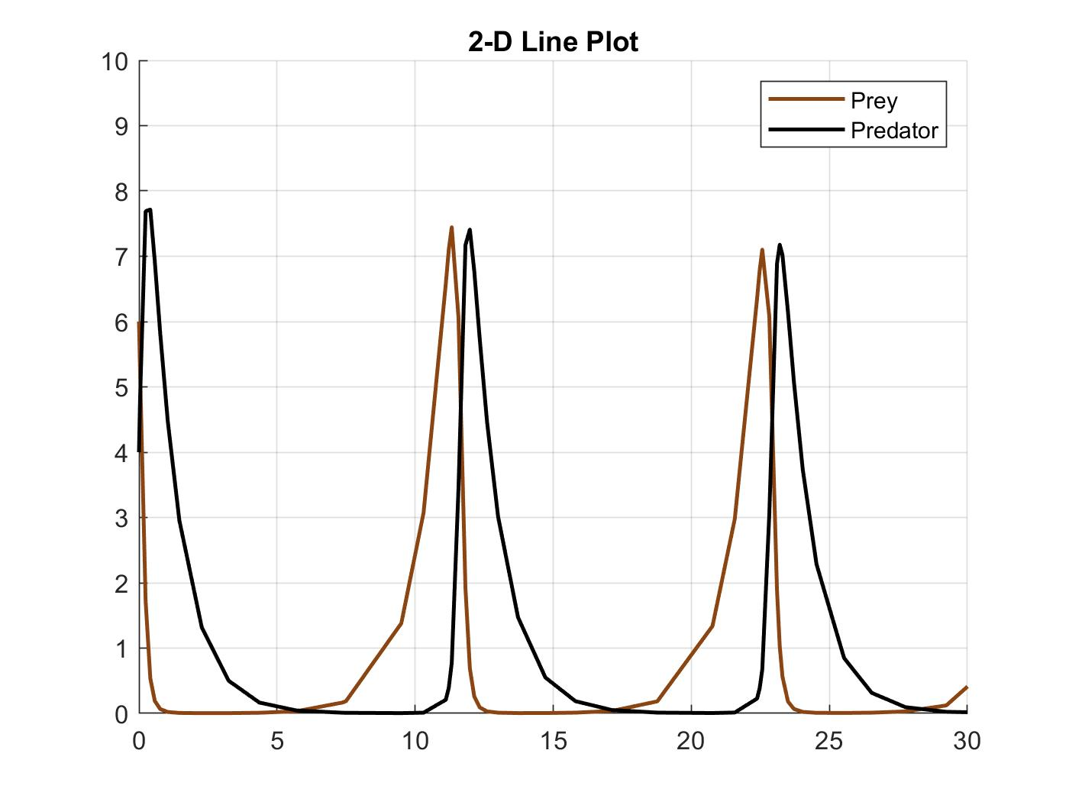
Analysis
Stability
Notes:
Here you can se another downfall with the model that is that the populations can reach zero and then move up again which in our case is a bit unrealistic, but nonetheless, all of the
Nonlinear dynamics are still here. As you can see, the model oscillates with a constant period, where the predator population trajectory is a bit phase shifted from the prey population. This makes
Sense since the predator population is solely dependent on how large the prey ppoulation is, and if left with no prey will decrease exponentially. This just goes on forever.

Slide 4
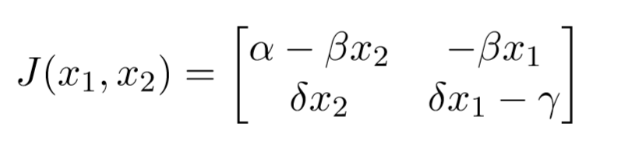
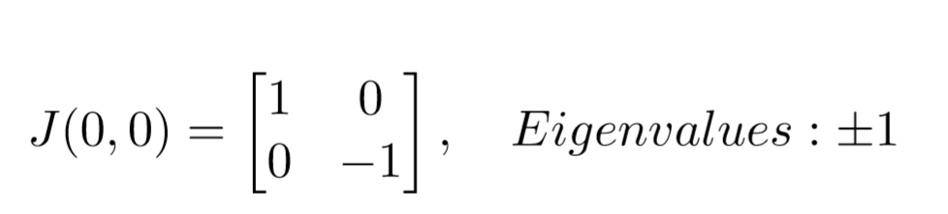
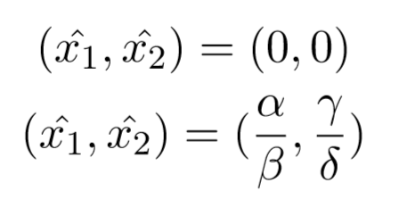
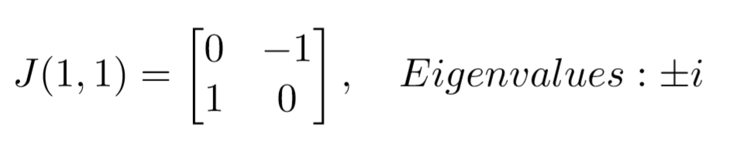
Analysis
Stability
Nature of the equilibria
Jacobian
Saddle and center
Notes:
To check if local or global stability is possible for the derived model, one have to determine all equilibria and analyse local and global stability property for all xeq. Thestabilityqualities can be analysed with the help of phase portraits and linearization. All of the equilibrium’s are isolated. By linearization and checking the eigenvalues, one can determine the nature of the equilibrium. Qualitative analysis is done by assuming that the trajectories of the nonlinear system in a small neighbourhood of an equilibrium to be quite close to the linearized trajectory. The jacobian matrix of the system is given by:
A eigenvalue which are purely real value is considered hyperbolic

Slide 5
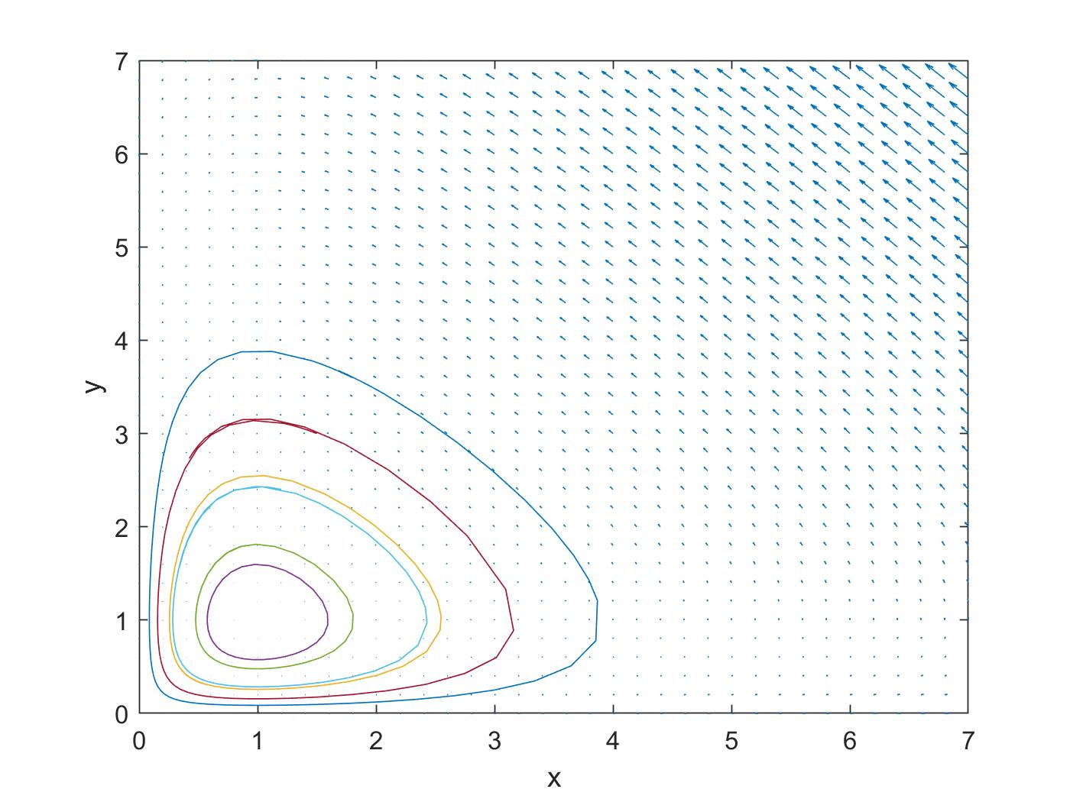
Analysis
Stability
Notes:
To check the equilibria at xeq more accurately a phase portrait of the uncontrolled system is shown in ﬁgure 14 with a plot of the trajectory in ﬁgure 6. Vector field magnitudes to the left are larger
When x_! Or the prey population is large which coincide with our earlier analysis, and get lower the lower the populations gets. The trajectgories seems to circle around (1,1) like our earlier analysis showed. Origio is not that readable or clear due to the fact that we are only focusing on whats happening in the first quadrant due to our constraints.

Slide 6
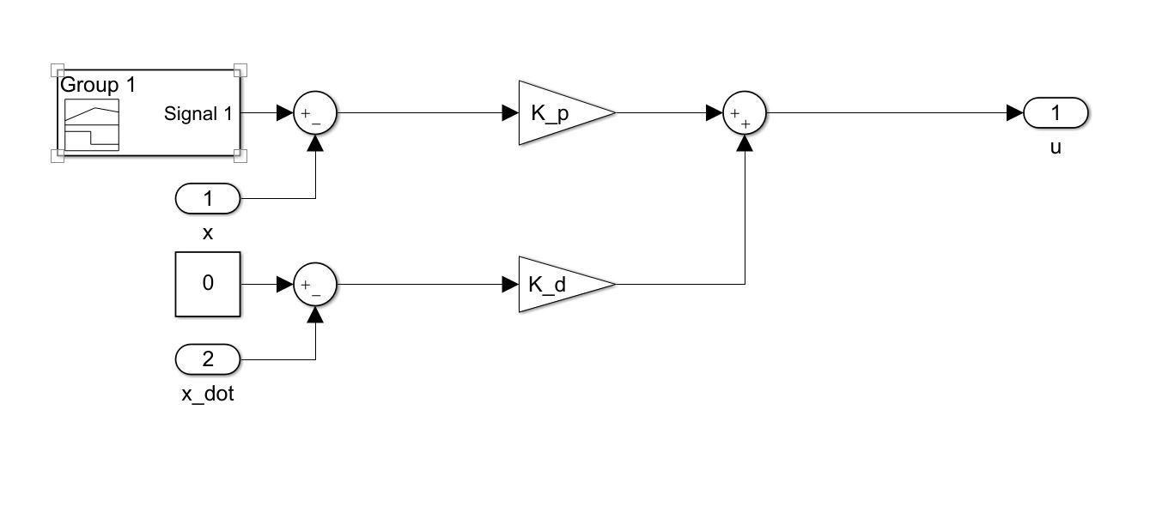
Methods
PD
SISO
Industry standard
Change of reference
Notes:
For reference, a simple PD was tuned and used to gather raw data. The reference for the amount of prey or household animals which are desired are provided by a signal builder in simulink which forces xref to go from 5 to 7 after 7.5 time steps. In this case, the system is a SISO. The simulink model can be seen in ﬁgure 1. The implemented PD controller can be seen in ﬁgure 4 with Kp = 5 and Kd = 7.

Slide 7
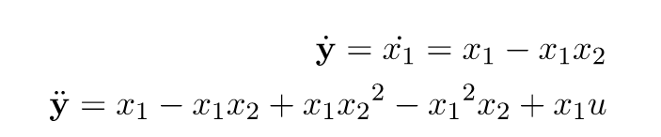
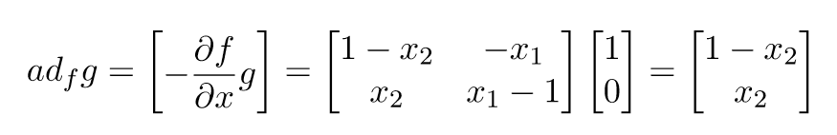
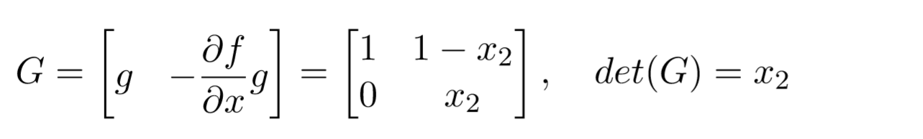

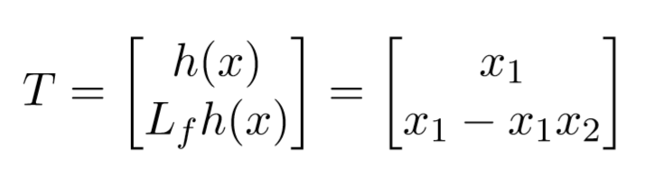
Methods
Feedback Linearization
Z transformation
Relative degree
No zero dynamics
Fully linearizable
Feedback linearizable
Notes:
Feedback Linearization considers a class of nonlinear systems of the form found in equation 3 and pose the question of whether there exist a state feedback control in the form of the one in equation 13 and a change of variables z = T(x) that transform the nonlinear system into an equivalent linear system. This renders a linear input–output map between the new input and the output. An important assumptions is that the transformation T, must be diﬀeomorphism with T(0) = 0 for the new system in its "normal form" to be equivalent to the old system. This makes it possible to prove that by choosing the input in the form shown in equation 13 one can achieve stability. Reason behind this transformation from x-coordinates to z-coordinates is that the theory and methodologies which is usually used in linear systems, can be applied once a nonlinear system has been exact linearized.
The smallest integer for which the input appears is referred to as the relative degree. In this case, the relative degree is 2, and the system is therefor feedback linearizable. The relative degree of a system can be seen on as the diﬀerence between the degrees of the denominator and numerator polynomials of the transfer function, H(s). Since ρ = n = 2, which implies that the system has no zero dynamics, and by default is said to be a minimum phase.

Slide 8
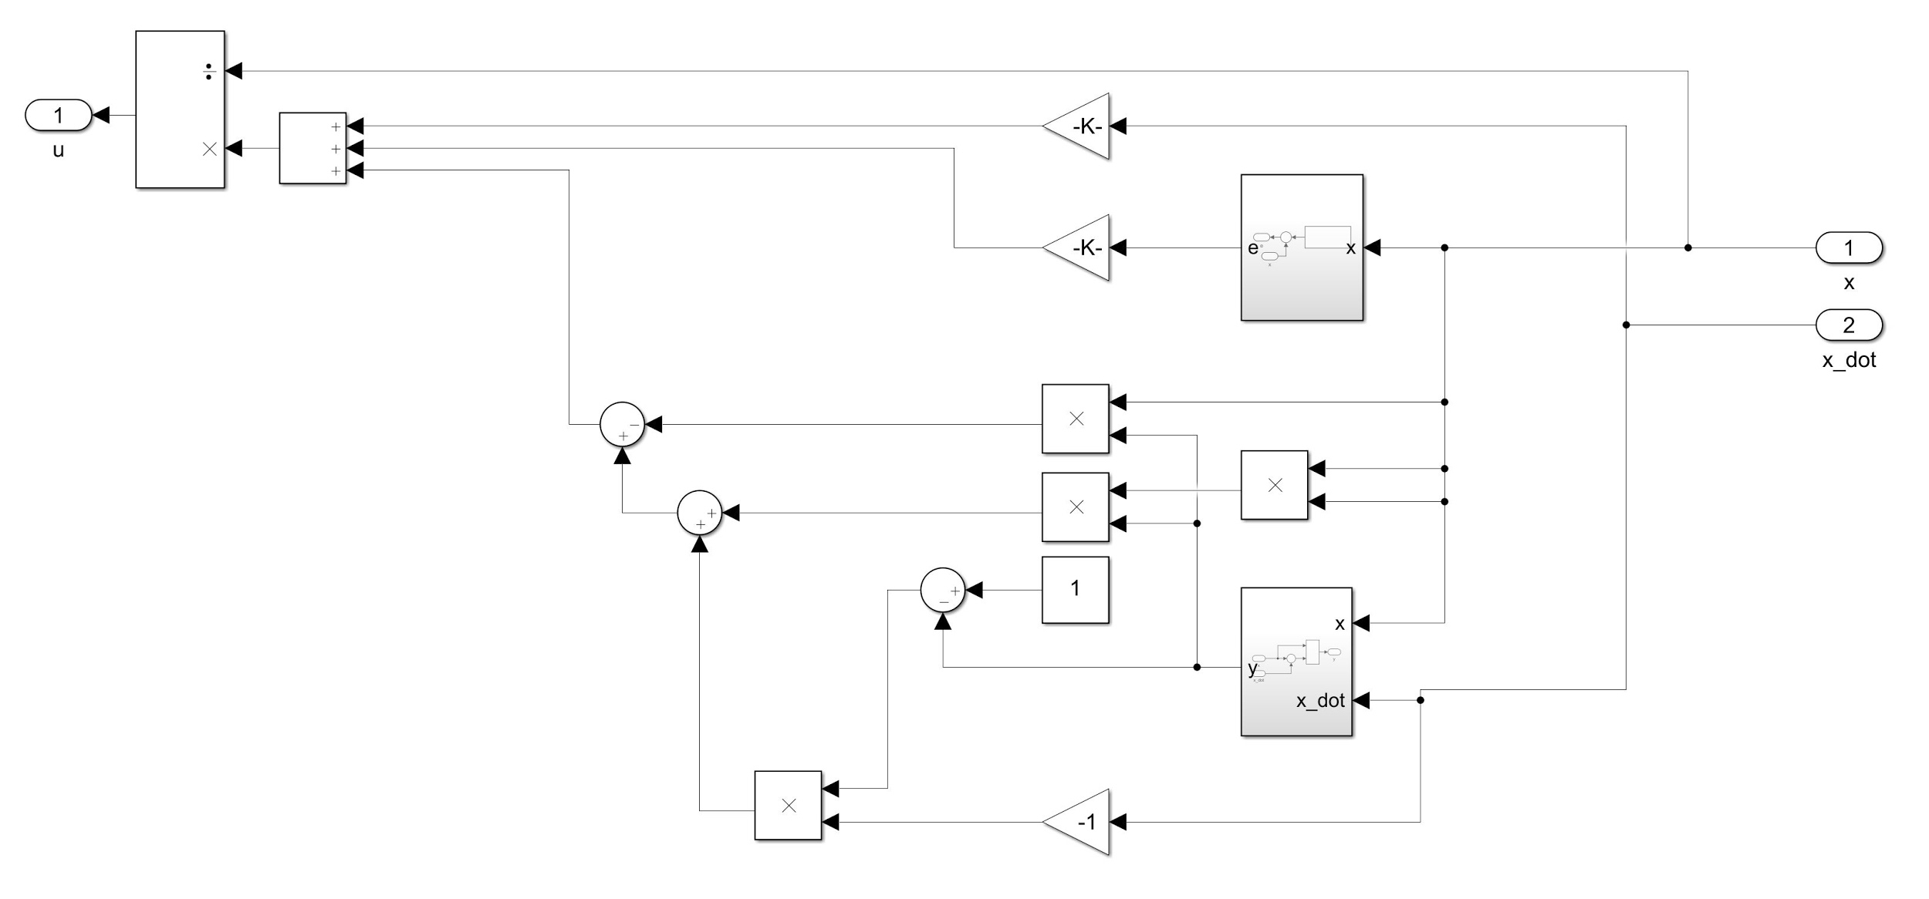
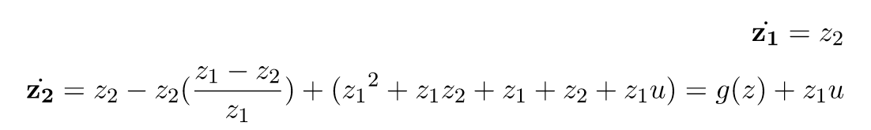

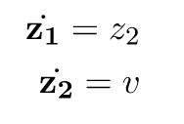
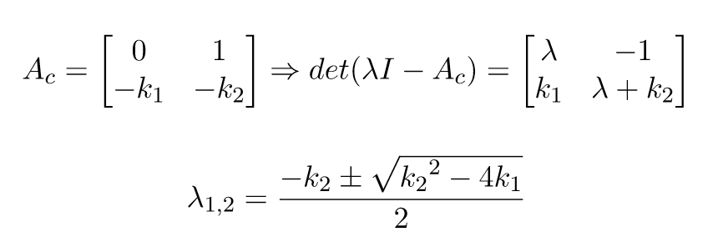
Methods
Feedback Linearization
State feedback control
(k_1,k_2)=(4,18)
Notes:
One can develop a state feedback control by utilising feedback linearization. Since feedback linearization have already been proved. where v = -Kz where K can be constructed so that matrix A in equation 26 is hurwitz and poles in good placements. The poles can be chosen, and the resulting poles will be decided by equation 27. v is in this case a onedimensional transformed input created by feedback linearization.
In this case, k1,k2 = (4,18) which gives poles at λ1,2 = ±9 + √77. By deﬁning the error as x1 −xref, generates the simulink model seen in ﬁgure 2 with the controller in ﬁgure 5

Slide 9
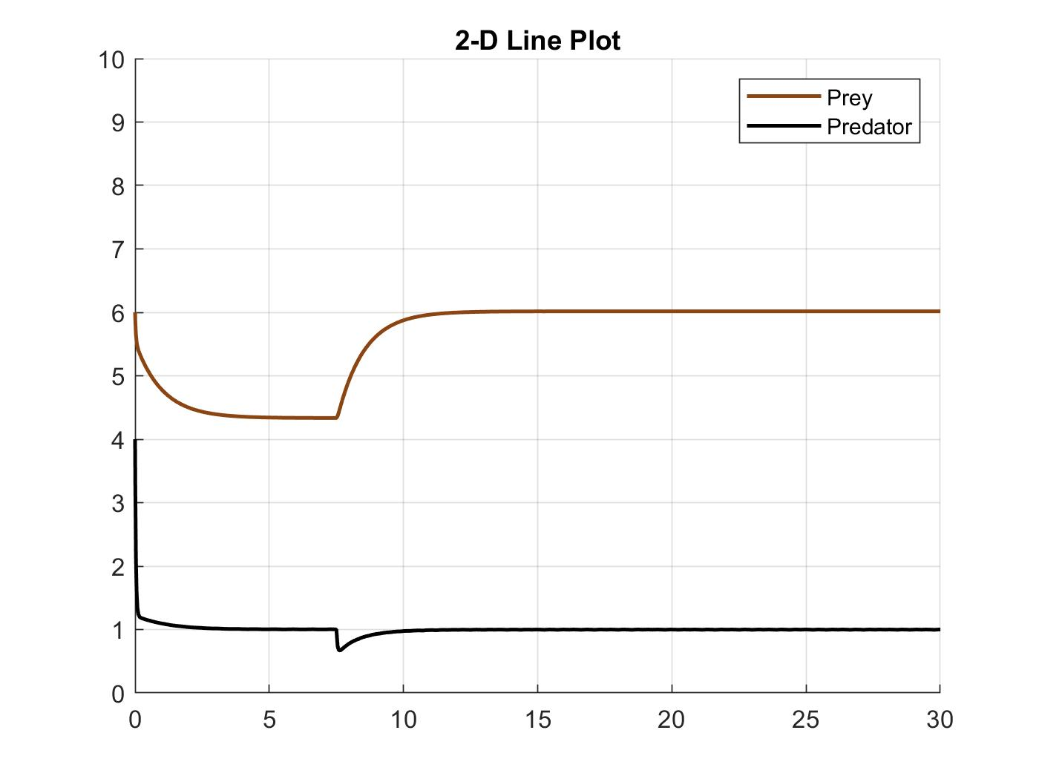
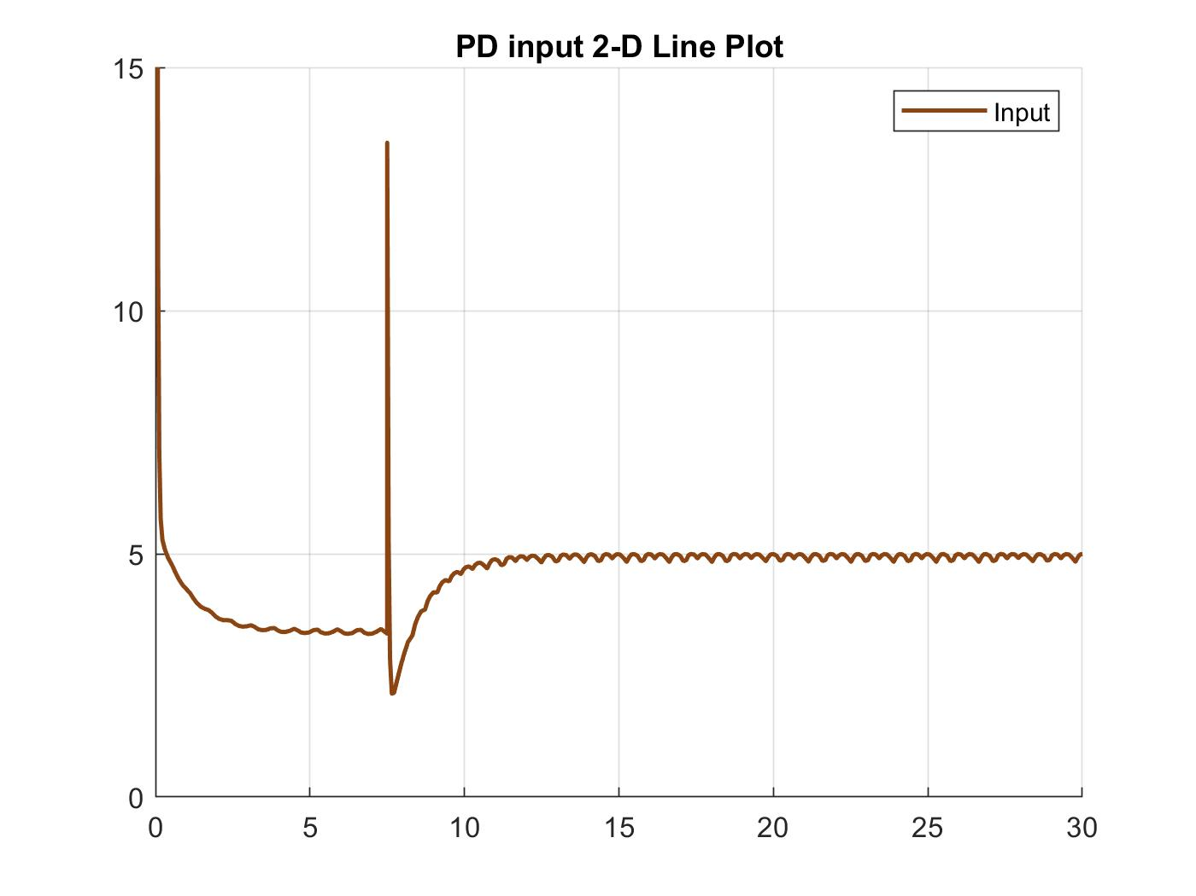
Results
PD

Slide 10
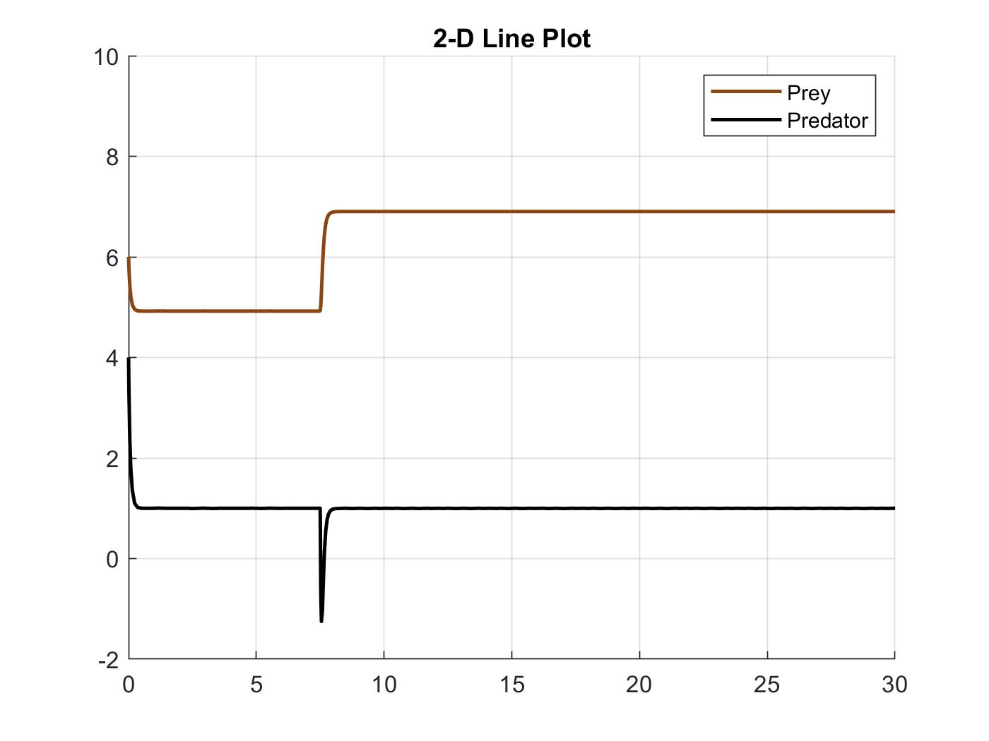
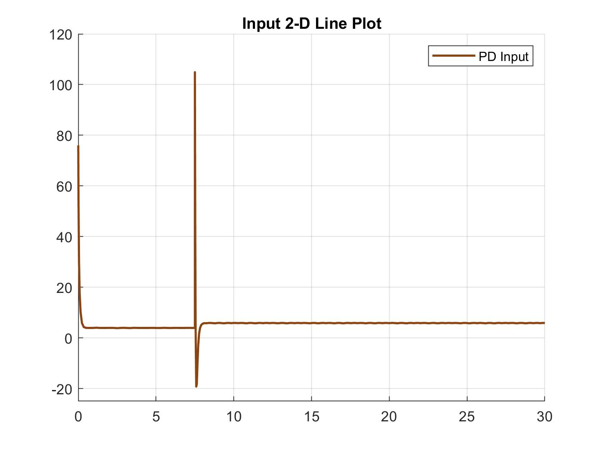
Results
PD
Notes:
Kp to 50

Slide 11
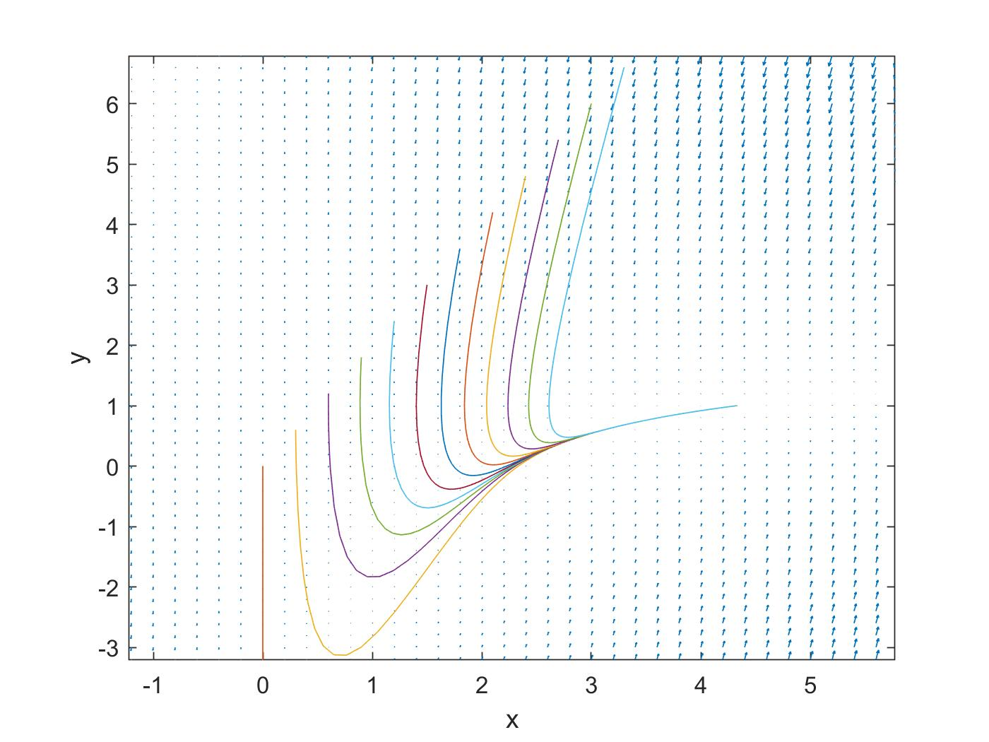
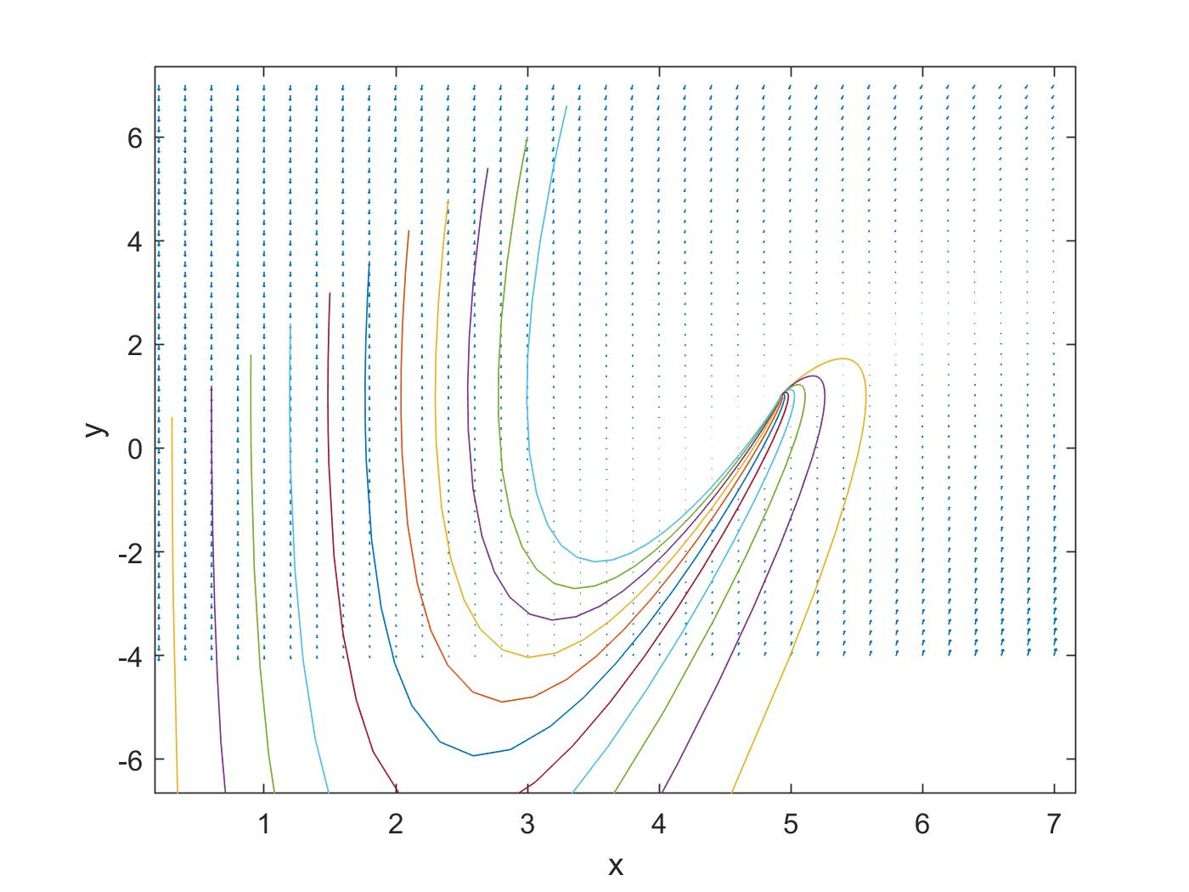
Results
PD
Notes:
This will not be realistic, due to the fact that the predator population become negative during the transition at timestep 7.5 where xref goes from 5 to 7. One can also look at the the input plot in ﬁgure 12 that the input goes negative which also breaks the constraint. The input spikes at the transition to over 100, which is non feasible in most cases whereas in the case with lower Kp, the input plot in ﬁgure 11 never goes under zero and spikes at a reasonable point.
ere every trajectory which starts at x,y > 0 ends up violating the constraint by ending up in the fourth quadrant.The only feasible solution which fullﬁlls the desired steady state is therefor Kp = 5. Nonetheless which Kp is used, the vector ﬁeld have the same qualitative behaviour by pointing downwards before converging into the equilibrium point. A interesting note is that the arrows point upwards if your in the fourth quadrant, which is in our case not so important

Slide 12
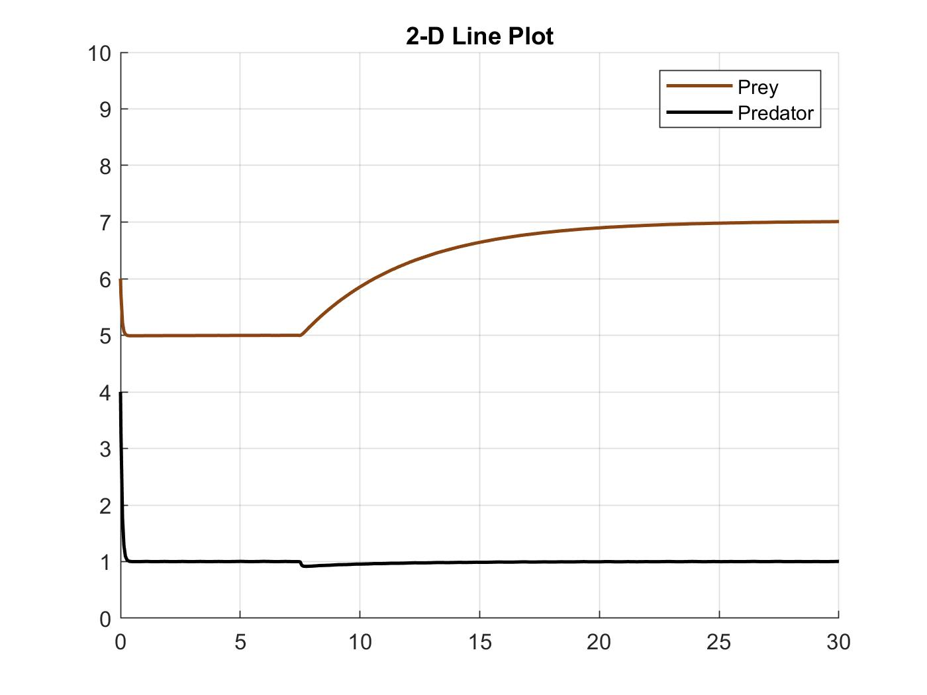
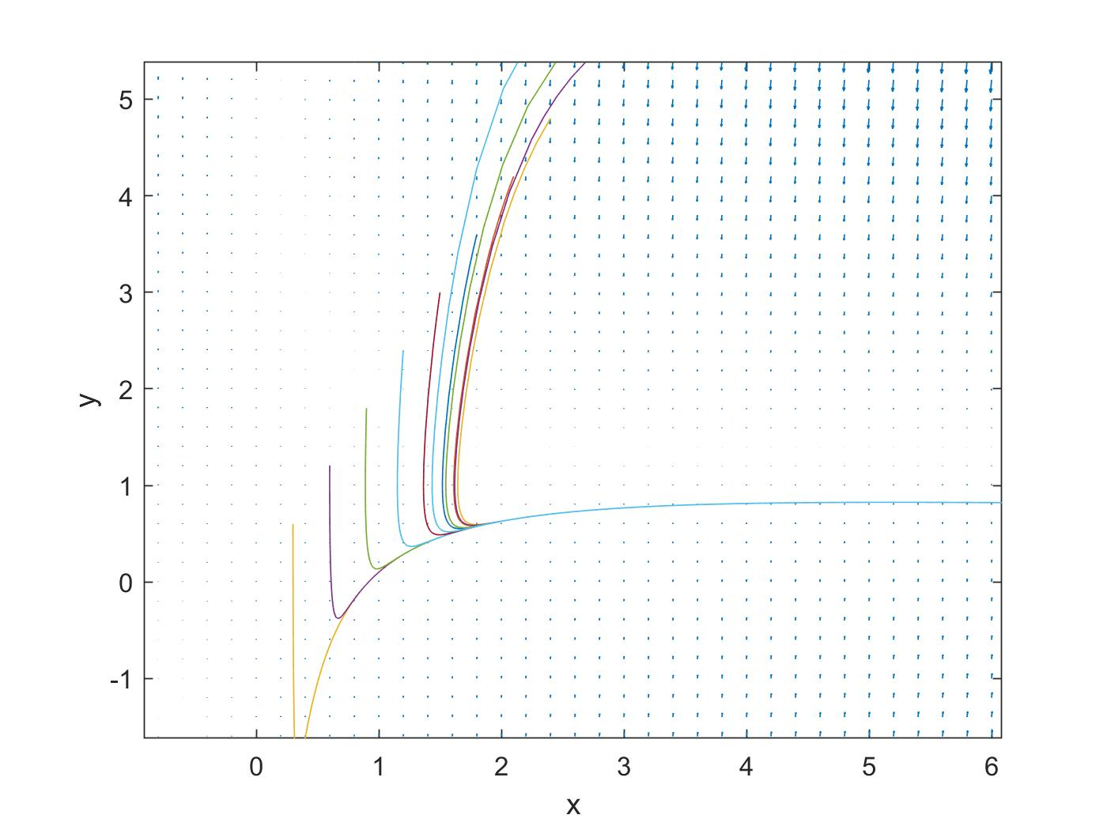
Results
Feedback Linearization
Notes:
The generated 2-D line plot of the state trajectories can be seen in ﬁgurhe feedback linearized one is much smoother, quickly converging to 5 before converging to 7 at the transition time. The decrease in the predator solution at the transition time is minimal and very smooth, compared to the PD one. compared to the PD one. The resulting input plot can be seen in ﬁgure 13 which is fairly good. The peak is somewhere over 5, and is a realistic peak, and much lower than the ones the PD controller generated. It oscillates a bit, but manages to drive the prey trajectory to the desired steady state without much problem

Slide 13
Discussion
Phase portrait comparison
Notes:
The dynamic of the system can be further analyzed with the use of phase portraits. The phase portrait of the system with feedback linearization can be seen in 17. This one have a much sharper trajectory down to 1 before slowly converging into a straight line. Compared to the PD phase portrait which is shown in ﬁgure 15, the feedback linearized one is much more lenient with the initial conditions and it is just when the predator population starts around 1.8 that the trajectory goes into the fourth quadrant and therefore violates the constraints.

Slide 14
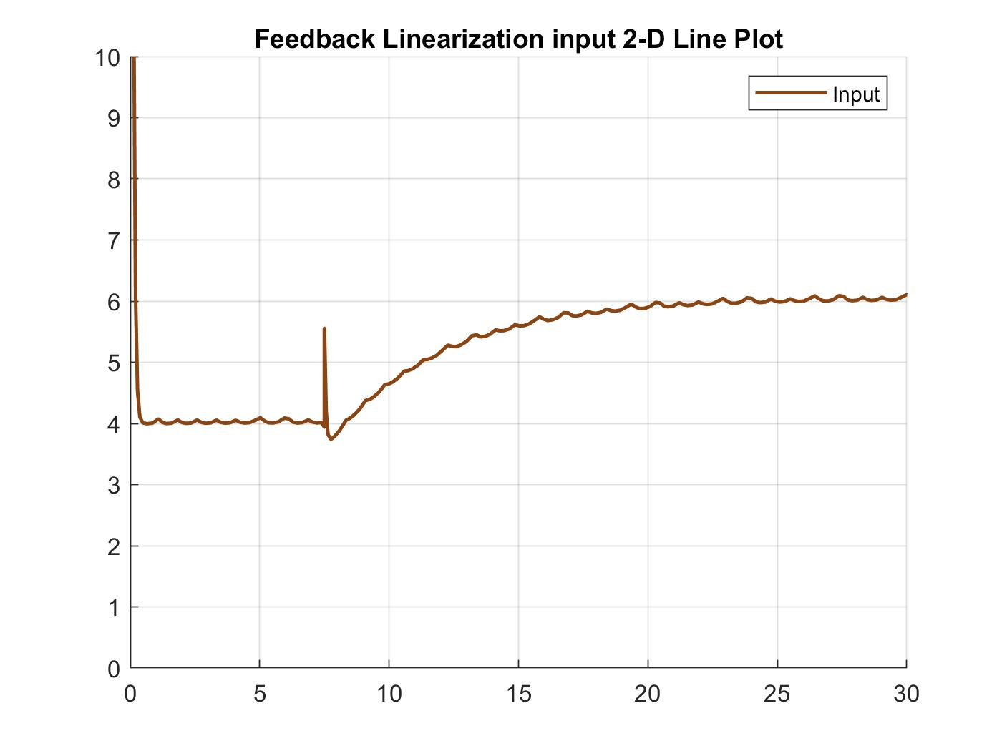
Discussion
Input comparison

Slide 15
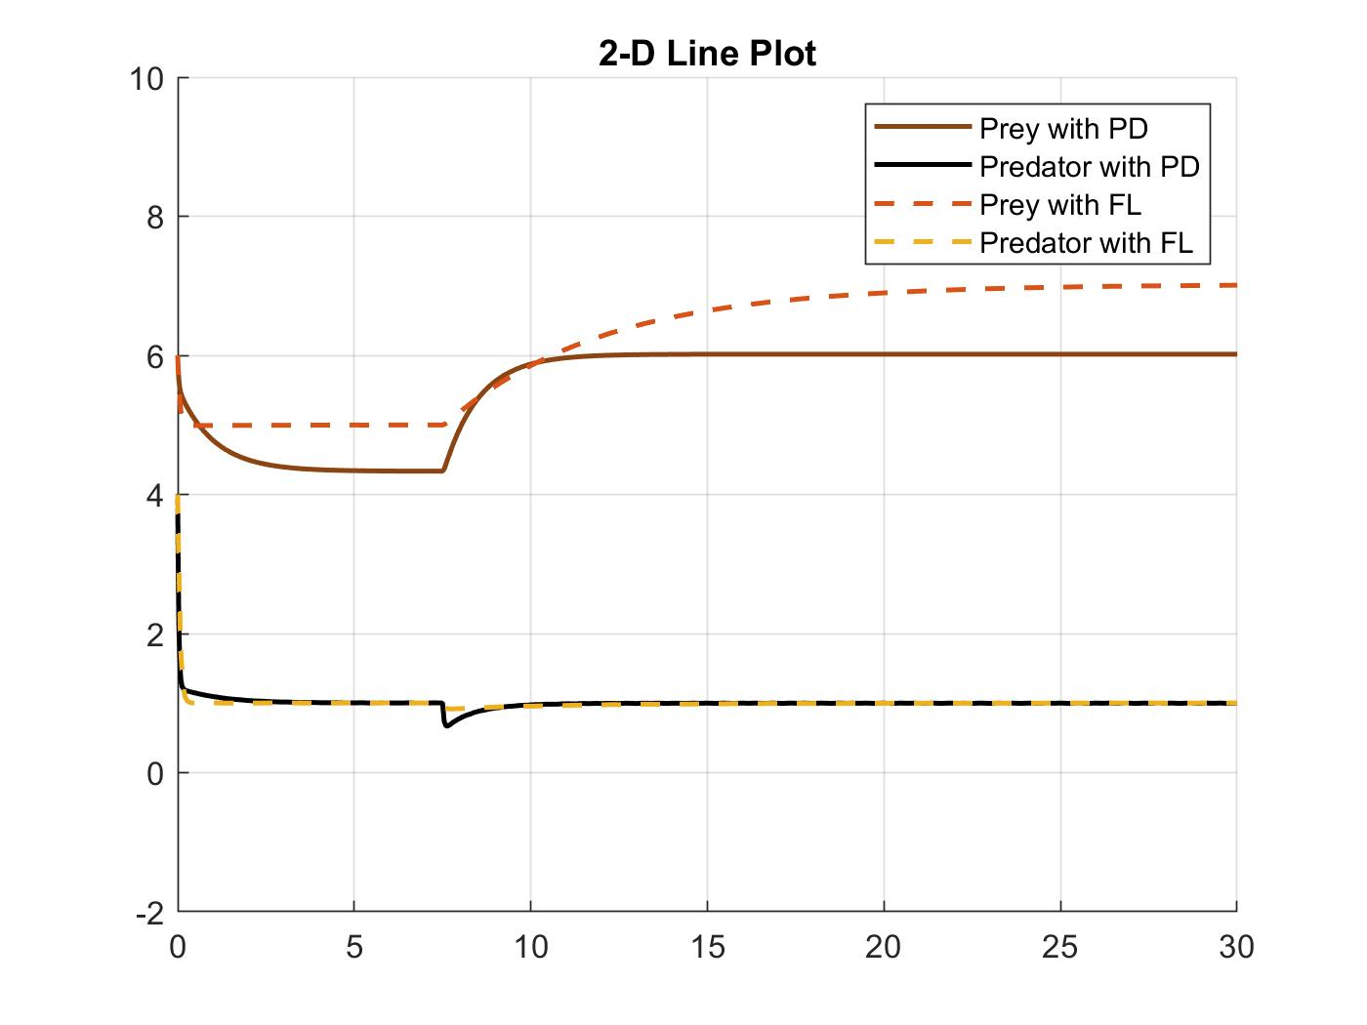
Discussion
Trajectory comparison
Notes:
There is also the question if feedback linearization is better than PD in the sense that x2 was used in the generation of uFL, and the feedback would therefor be ideal and exact, and would therefore always be better than a PD controller. An argument against that is that one could always construct and observer to estimate the missing state with the use of for example a high gain observer. Something else that is also very common in agriculture is the direct control of the prey or in this case household population by introducing a input in ˙ x1 at equation 1. This could had lead to better control of the system, and ultimately led to a smoother trajectory.

Slide 16
Discussion / Conclusion / Future work
Different kind of observer
Perturbation and noise

